Slide 1
Earth Science Revision

Slide 2
Answer each question to the best of your ability.
Ensure you have read the question carefully before answering
Test conditions will apply

Slide 3
1 Alfred Wegener proposed the theory of continental drift. Which of the following observations did he use to support his theory?
A Fossils could be found in different countries.
B Africa and South America seemed to fit together like jigsaw pieces.
C Rocks had magnetic striping near the ocean ridges.
D The sea floor seemed to be made at the ridges.

Slide 4
2 Harry Hess proposed a mechanism by which Wegener’s continental drift could occur. Hess’s theory was called:
A plate tectonics
B continental drift
C seafloor spreading
D subduction

Slide 5
3 Magnetite is a magnetic mineral that can be found in basalt, which is common in oceanic crust. Magnetite enabled scientists to obtain evidence of:
A seafloor spreading
B Earth’s magnetic field
C subduction
D tectonic plates

Slide 6
4 Evidence of spreading of the crust at ocean ridges resulted from:
A seismic activity in the Earth’s crust
B differences in density of oceanic and continental crust
C subduction of plates at collision boundaries
D reversals in the Earth’s magnetic field

Slide 7
5 An island chain, such as the Hawaiian Islands, provided evidence for which tectonic process?
A plate movement
B subduction
C collision boundaries
D rifting

Slide 8
6 Which of the following converging boundaries is most likely to produce mountain ranges?
A continent-ocean
B ocean-ocean
C continent-continent
D any converging plate boundary can produce mountains

Slide 9
7 An oceanic trench can form when:
A an oceanic and continental plate collide at a converging plate boundary
B an oceanic and continental plate collide at a diverging plate boundary
C an oceanic and continental plate collide at a transform plate boundary
D two continental plates collide at a converging plate boundary

Slide 10
8 A tsunami is:
A a type of underwater earthquake
B a series of large waves resulting from an underwater earthquake
C a type of volcanic eruption
D a series of large waves that result in sea-floor spreading

Slide 11
9 The Earth’s crust consists of a number of pieces called tectonic:
A ridges
B boundaries
C continents
D plates

Slide 12
10 Which is the layer of the Earth that contains convection currents?
A Crust
B Mantle
C Outer core
D Inner core

Slide 13
11 The Hawaiian Islands are in the middle of the Pacific Plate and not near a mid-ocean ridge. Explain why there is evidence of volcanic activity on the Hawaiian Islands.

Slide 14
12 The fossil fern Glossopteris has been found in South America, Africa, India, Australia and Antarctica. How is this evidence for continental drift?

Slide 15
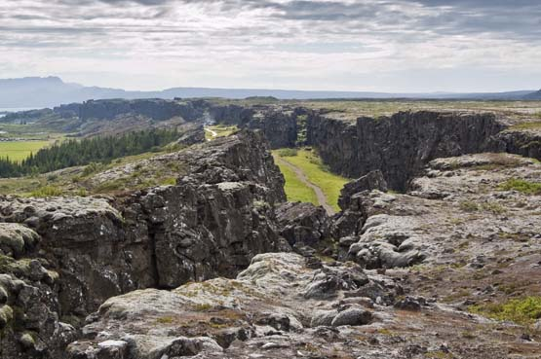
13 Describe how a rift valley is formed.

Slide 16
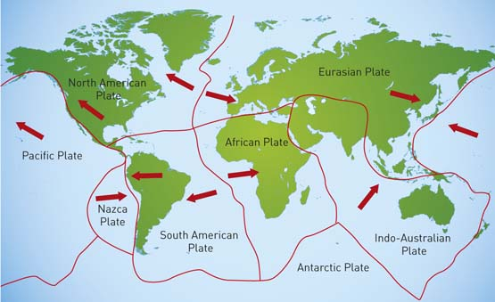
14 The map shows the movement of tectonic plates in the present day. Explain why there are more earthquakes in New Zealand than in Australia.

Slide 17
15 List five pieces of evidence that support the theory of continental drift.

Slide 18
16 What is the difference between constructive and destructive plate boundaries?

Slide 19
17 True or False: when a fluid is heated, it becomes more dense and rises.

Slide 20
18 What are three landforms that are created at continent-ocean collision boundaries?

Slide 21
19 Why does oceanic crust subduct when it collides with continental crust?

Slide 22
20 List as many tectonic plates as you can.

Slide 23
Answers

Slide 24
1 Alfred Wegener proposed the theory of continental drift. Which of the following observations did he use to support his theory?
B Africa and South America seemed to fit together like jigsaw pieces.

Slide 25
2 Harry Hess proposed a mechanism by which Wegener’s continental drift could occur. Hess’s theory was called:
C seafloor spreading

Slide 26
3 Magnetite is a magnetic mineral that can be found in basalt, which is common in oceanic crust. Magnetite enabled scientists to obtain evidence of:
A seafloor spreading

Slide 27
4 Evidence of spreading of the crust at ocean ridges resulted from:
D reversals in the Earth’s magnetic field

Slide 28
5 An island chain, such as the Hawaiian Islands, provided evidence for which tectonic process?
A plate movement

Slide 29
6 Which of the following converging boundaries is most likely to produce mountain ranges?
C continent-continent

Slide 30
7 An oceanic trench can form when:
A an oceanic and continental plate collide at a converging plate boundary

Slide 31
8 A tsunami is:
B a series of large waves resulting from an underwater earthquake

Slide 32
9 The Earth’s crust consists of a number of pieces called tectonic:
D plates

Slide 33
10 Which is the layer of the Earth that contains convection currents?
B Mantle

Slide 34
11 The Hawaiian Islands are in the middle of the Pacific Plate and not near a mid-ocean ridge. Explain why there is evidence of volcanic activity on the Hawaiian Islands.
The Hawaiian Islands have been formed by volcanic hot spots (a plume of magma rises through the crust and creates underwater volcanoes).

Slide 35
12 The fossil fern Glossopteris has been found in South America, Africa, India, Australia and Antarctica. How is this evidence for continental drift?
The fern could not walk / fly / swim, so the continents it appears on were once all connected. As they drifted apart, the ferns were taken along with them and now appear on separate continents.

Slide 36
13 Describe how a rift valley is formed.
Rift valleys are formed when mantle rock rises, lifting and thinning out the continental crust. This occurs at a diverging plate boundary. Cracks form and large slabs of rock sink into the Earth, forming a rift valley.

Slide 37
14 The map shows the movement of tectonic plates in the present day. Explain why there are more earthquakes in New Zealand than in Australia.
Australia is located in the centre of a plate (the Indo-Australian Plate). New Zealand lies on the boundary of two plates (the Indo-Australian Plate and the Pacific Plate). There is pressure between the two plates causing them to collide and slide against each other, creating earthquakes.

Slide 38
15 List five pieces of evidence that support the theory of continental drift.
Fossil evidence
Shape of the continents
Coal deposits
Glacial scars
Mountain ranges/rock types

Slide 39
16 What is the difference between constructive and destructive plate boundaries?
Constructive boundaries create new crust, while destructive boundaries destroy crust material.

Slide 40
17 True or False: when a fluid is heated, it becomes more dense and rises.
False: it becomes less dense.

Slide 41
18 What are three landforms that are created at continent-ocean collision boundaries?
Mountains
Ocean trenches
Volcanoes

Slide 42
19 Why does oceanic crust subduct when it collides with continental crust?
Oceanic crust is more dense than continental crust, so it sinks into the mantle when the two plate types collide.

Slide 43
20 List as many tectonic plates as you can.
Australian
African
South American
North American
Juan de Fuca
Philippine
Nazca
Antarctic
Scotia
Caribbean
Cocos
Arabian
Pacific
Indian
Eurasian
Sunda

